Slide 1
Real Estate Old and Young Sharks
‘AFFORDABLE HOUSING IN EUROPE’ - VIRTUAL ROUNDTABLE
“Old Sharks” {Counselors of Real Estate® - seasoned real estate industry professionals}
vis-à-vis
“Young Sharks” {up to 35 years of age}
60 mins + 15 mins Q&A
December 4, 2024
9 AM Chicago CST/ 10 AM NYC – Montreal EST
3 PM London GMT/ 4 PM CET/ 5 PM Athens EET – Istanbul EEST

Slide 2
Real Estate Old and Young Sharks
‘AFFORDABLE HOUSING IN EUROPE’ - VIRTUAL ROUNDTABLE
EVENT OUTLINE
Welcome by European Chapter Chair, Eduard Forejt, CRE, Development Director, PasserInvest, Prague
Introduction of distinct European approaches by moderator, Jana Seckarova, CRE, Partner, Natland, Prague [10 mins]
Presentation:
Current situation: Czech Republic, Austria, Spain, former Yugoslavia, and highlights of hurdles we navigate [20 mins]
Interaction/Discussion: What are some of the possible solutions to the issue? [30 mins]
Q&A [15 mins]
SPEAKERS:
Ms. Jana Seckarova, CRE, Partner, Natland, Prague
Mr. Jiri Kubanek, Investment Analyst, BTR Consulting, Prague
Dr. Anton Bondi de Antoni, CRE, Managing Partner, Bondi Consult GmbH, Vienna
Mr. Christoph Nemetschke, Certified Legal Officer & Project Manager, Bondi Consult GmbH, Vienna
Mr. Fernando Rodriguez-Lluesma, CRE, Senior Director, ACR, Madrid
Mr. Javier Lecumberri, Architect & Project Director, AH Asociados, Navarra
Mr. Vlad Ilić, CRE, Chief Executive Officer, Sarufo, Belgrade
Ms. Milica Vučković, Architect, Founder & Creative Director, AterierM, Belgrade

Slide 3
Czech Republic

Slide 4
HOUSING UNAFFORDABILITY CHANGE FROM 2015
RANK | EU COUNTRY | CHANGE IN HOUSE PRICE TO INCOME RATIO 2015-2023
1. | Portugal | + 47%
 | …
4. | Austria | + 22%
5. | Czechia | + 21%
 | …
7. | Slovenia | + 15%
 | ...
9. | Spain | + 12%
 | …
12. | Germany | + 10%
 | …
14. | EU average | + 8%
 | …
18. | Croatia | + 2%
 | …
28. | Romania | - 37%
“Old Sharks” {Counselors of Real Estate® - seasoned real estate industry professionals}
vis-à-vis
“Young Sharks” {up to 35 years of age}
60 mins + 15 mins Q&A
Source: Eurostat

Slide 5
HOUSING UNAFFORDABILITY
“Old Sharks” {Counselors of Real Estate® - seasoned real estate industry professionals}
vis-à-vis
“Young Sharks” {up to 35 years of age}
60 mins + 15 mins Q&A
Source: Numbeo

Slide 6
HOUSING AFFORDABILITY - PRAGUE
“Old Sharks” {Counselors of Real Estate® - seasoned real estate industry professionals}
vis-à-vis
“Young Sharks” {up to 35 years of age}
60 mins + 15 mins Q&A
Source: BTR Consulting

Slide 7
HALF OF ADULT TENANTS IN CZECHIA ARE BETWEEN 20 AND 39 YEARS OLD
“Old Sharks” {Counselors of Real Estate® - seasoned real estate industry professionals}
vis-à-vis
“Young Sharks” {up to 35 years of age}
60 mins + 15 mins Q&A
56% in Prague
Source: Czech Statistical Office (Census 2021), the data represent only cities with more than 10,000 inhabitants

Slide 8
What they plan (considering their financial situation)
What they’d like (not considering their financial situation)
WHY?
HALF OF ADULT TENANTS IN CZECHIA ARE BETWEEN 20 AND 39 YEARS OLD
BECAUSE (UN)AFFORDABILITY
Source: The Czech Academy of Sciences, the data represent about 600 respondents of age 18-35 years from only 4 Czech cities

Slide 9
PEOPLE CHANGE, APARTMENTS DON'T
MORE PEOPLE LIVE ALONE OR AS CHILDLESS COUPLES.
BUT
APARTMENT SIZES REMAIN CONSTANT.
HALF OF PRAGUE'S APARTMENTS ARE SINGLE-OCCUPIED (AVG. 55 SQ M)
= APARTMENTS ARE UNNECESSARILY BIG, AND THEREFORE EXPENSIVE
“Old Sharks” {Counselors of Real Estate® - seasoned real estate industry professionals}
vis-à-vis
“Young Sharks” {up to 35 years of age}
60 mins + 15 mins Q&A
Source: Eurostat

Slide 10
POSSIBLE SOLUTIONS
1. | MARKET-BASED SOLUTION
2. | GOVERNMENT SOLUTION
3. | SOCIALLY RESPONSIBLE BUSINESSES
“Old Sharks” {Counselors of Real Estate® - seasoned real estate industry professionals}
vis-à-vis
“Young Sharks” {up to 35 years of age}
60 mins + 15 mins Q&A
Source: Eurostat

Slide 11
MARKET-BASED SOLUTION = SMALLER APARTMENTS
 | USUAL |  |  |  | IDEAL FOR RENTAL LIVING
TYPE OF APARTMENT ↓ | SIZE (SQM) | RENT (EUR/SQM/MONTH) | RENT (EUR/MONTH) |  | SIZE (SQM) | RENT (EUR/SQM/MONTH) | RENT (EUR/MONTH) |  | RENT SAVING (EUR) |  | HIGHER INVESTOR'S REVENUE PER SQM
STUDIO | 40 | 22 | 880 |  | 25 | 32 | 800 |  | -80 |  | +45%
2 ROOMS + KITCHEN + BATHROOM APARTMENT | 60 | 18 | 1080 |  | 40 | 23 | 920 |  | -160 |  | +28%
3 ROOMS + KITCHEN + BATHROOM APARTMENT | 90 | 15 | 1350 |  | 60 | 18 | 1080 |  | -270 |  | +20%
Source: BTR Consulting

Slide 12
GOVERNMENT SOLUTION = SUBSIDY
CZECH PROGRAMME OF AFFORDABLE HOUSING (2024)
supported by the European Union
25% subsidy + 65% discounted loan + 10% equity = 100%
100 % ≤ 10 000 000 EUR
for the purchase, construction or reconstruction of apartments
Cap on rent & Cap on indexation
Targeted at specific population groups
needed professions, young people, up to a certain income limit
Source: State Investment Support Fund

Slide 13
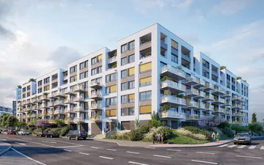
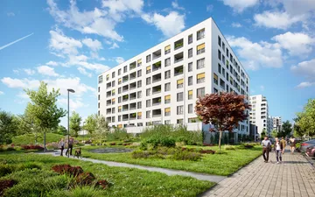
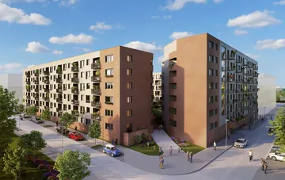
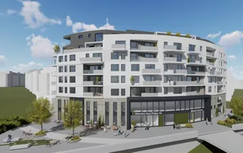
SOCIALLY RESPONSIBLE BUSINESSES
661 affordable rental apartments in construction
Rent up to 20% below the local market standard
Amadeus Residence
Project Harfa
For employees in supported professions primarily in the public sector (e.g., nurses, doctors, teachers, police officers, firefighters).
Opatov City
Prague 14
Source: Erste Group

Slide 14
Austria

Slide 15
Responsive planning and affordable housing in Europe
December 4th, 2024
WEBINAR
Problems and approaches in the Austrian housing market

Slide 16
Current status and problems
Construction Companies
Authorities
Nine different building codes
High level of bureaucracy
Long approval processes by authorities
Outdated and complex rent law, amendment / revision overdue
High level for promoted cooperatives for affordable housing – terms don’t reflect the market anymore
Decline in completions by more than 25%, supply lower than demand
High demands concerning sustainability, therefore high costs
Terms of promotions vs. high construction costs
Generally
Owners & Tenants
General imbalance: High percentage of subsidized housing vs. regulated rent
More than 80% of rents (Vienna) are already regulated
Transformation commercial to housing, extremely difficult due to legal regulations
Increasing land prices – ownership becomes unaffordable
High maintenance costs vs regulated rent
Affordable housing with low supply
Rising rent prices
04.12.2024

Slide 17
Status in Vienna
There are approx. 950,000 apartments in Vienna
Approx. 50% of which are single households
72% are subsidized apartments
The City of Vienna is the largest private owner of apartments in Austria with approx. 220,000 apartments
Only 28% of the flats are privately owned and are therefore not subject to rent restrictions
31% of Viennese live in municipal housing (Gemeindebau)
04.12.2024

Slide 18
Approaches
Innovative living concepts (e.g. Mixed Housing, Young Professionals and Senior Residences)
Lower regulation more personal responsibility, including all stakeholders
Reduction of bureaucracy / faster approval processes
Adaption of terms of promotions to market demand
Revision of rent law
Loosening of financing conditions (KIM Verordnung)
Government / city to provide affordable properties, e.g. via leasehold
Promoted housing: Reduction of standards in construction quality to reduce construction costs
04.12.2024

Slide 19
Spain

Slide 20
Affordable Housing - Case Study Spain
CRE Webinar - 4th December 2024

Slide 21
MAIN FIGURES – CASE STUDY: SPAIN
Market Overview
Huge scarcity of Ready to Build Land
Prize of ready-to-Build land has rocketed since 2017
Banks do not finance land purchases
Current construction costs and land prices make any development economically unviable for a residential developer
Great unbalance between offer and demand (ci. 125,000 units per year)
Expected an even greater demand in the coming years.

Slide 22
MAIN FIGURES – CASE STUDY: SPAIN
Municipality´s Ready-to-Build land Concession for 65 years.
Reversion to the administration at the end of the concession period
Creation of a stock of affordable housing for the administration at zero cost.
STRUCTURE OF THE PROCESS
0 € Annual payment to administration
Typologies of 1, 2 and 3 bedrooms
Parking: Obligatory. Rent chargeable to the tenant.
Storage room: Compulsory. Rent chargeable to the tenant.
MANDATORY PRODUCT DESIGN
Cleaning of common areas, maintenance of buildings, garages and facilities.
Extra amenities ( > 5.000 m2 const.): swimming pool + gym + gardens
Kitchen equipment: induction hob, oven, sink and extractor hood.
A/C pre - installation
Maximum annual family income up to 63,000 € / year.
TARGET
4% adapted housing

Slide 23
MAIN FIGURES – CASE STUDY: SPAIN
Successful scheme on numbers
9,695 units of affordable housing designed
703.619 sqm under construction
1,255 millions invested -Madrid Region-
3 Concessional process launched since 2021
New awarding procedures planned for 2025
Spread of the model to other cities: Seville, Valencia and Malaga
Attraction of large international investment funds

Slide 24
Serbia/Slovenia

Slide 25
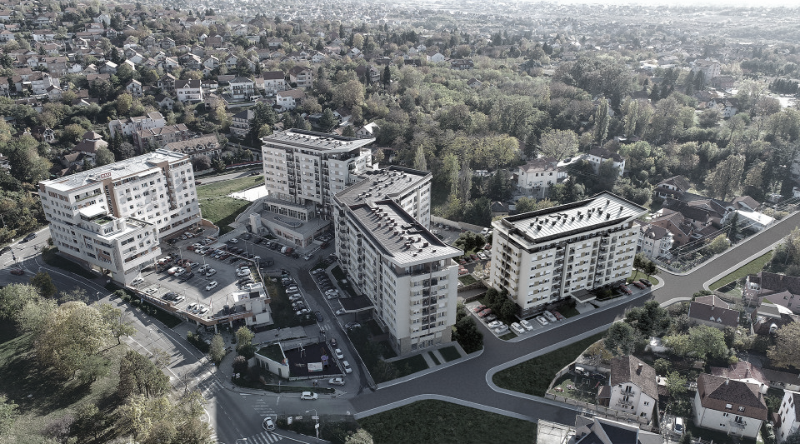
Affordable Housing: The Case of Serbia and Slovenia
CRE Webinar
December 4th, 2024

Slide 26
Affordable Housing in Serbia
Affordable housing in Serbia is a political issue that is brought up during each election cycle.
The government usually finances the development of social housing for a specific group; such as Police, Military, Academia, etc.
Plots of land, that are government owned, have been allocated for affordable housing in zoning plans, but they are still undeveloped to this day.
Little has been done in the form of public private initiative for building affordable housing.

Slide 27
Affordable Housing in Slovenia
According to Article 78 of the Slovenian Constitution, the State must create opportunities for citizens to obtain suitable accommodation.

Slide 28
Affordable Housing in Slovenia
Housing challenge in Slovenia
Housing fund in Slovenia was inherited from the communist regime of Yugoslavia, which resulted in high ownership, above 70%
Inherited an aging housing stock with low sustainability
Housing supply became restricted, and mobility decreased
The private rental market remained in its infancy
As a result, young families and first-time buyers have limited housing options

Slide 29
Affordable Housing in Slovenia
Slovenia needs 50,000 rental units
Has a 4.7 billion euros investment housing gap
Needs 3200 student housing units at an investment of 77.5 million euros
Available housing units is 400 per 1000 habitants
Since 2015 a 70% price increase for price of housing
Numbers

Slide 30
Affordable Housing in Slovenia Immigration
Slovenia to a large extent relies on non EU residents as work force.
Over 40% of non EU nationals live in overcrowded accommodations
General (total) overcrowding rate is 11.5%
Migration workers occupy overcrowded and low quality apartments and high rents are a burden to immigrant households.

Slide 31
Affordable Housing in Slovenia
Housing Fund of the Republic of Slovenia
Main state authority for the implementation of the national housing policy
Raised 25,5 million in 2023 and 25.5 million in 2024
Funds will be used to construct its own residential dwellings
Offers favorable loans to local and regional funds or municipalities
Fund owns 5000 non-profit rental-housing units and a further 787 units which are let at cost-based rents

Slide 32
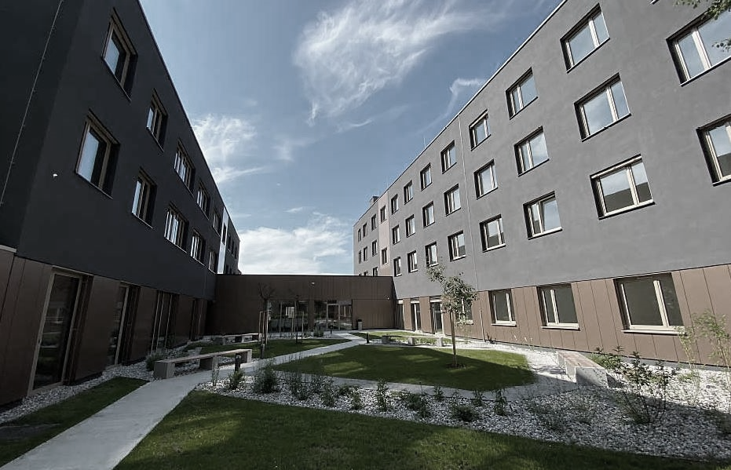
Affordable Housing in Slovenia
Innovative Solution
The CEB has provided two loans to the Housing Fund of the Republic of Slovenia:
€50 million in 2018
€70 million in 2021
enabling the HFRS to provide innovative housing solutions.
The Gerbičeva Youth Community building, which rents apartments to young professionals from the age of 18 to 29 at non-profit rates.

