Slide 1
Notes:
The Counselors of Real Estate’s member retention rate in 2024 was 92%. The Counselor culture, the exclusivity of the CRE credential, a reliable and responsive global network, and a reputation for quality thought leadership are among the reasons stated for maintaining affiliation with the organization in a transitional industry climate.

Slide 2
The Counselor Culture
Notes:
Access. Critical Thinking. Diversity of Thought and Expertise. Shared Experiences and Camaraderie. Philanthropic Spirit.

Slide 3
1,000 CRE® Colleagues
60 Professional Disciplines
22 Countries
27 CRE® Chapters Worldwide
72 Years
Notes:
The Counselors organization was established in 1953 with 36 charter members. Counselors now practice in 22 countries and offer expertise in more than 60 real estate disciplines across all asset classes. The CRE Chapter Network includes the Asia, European, and Canadian chapters, and 24 U.S. chapters. Efforts are progressing to expand the Counselor network into Latin and South America.

Slide 4
Our Signature Initiatives
TOP TEN ISSUES AFFECTING REAL ESTATE®
WEBINAR SERIES & PODCASTS
Compelling sessions offer expert interpretation and meaningful insight to inform and inspire the way you do business
Current and emerging issues expected to have the greatest impact on real estate
REAL ESTATE ISSUES®
ECONOMIC ADVISORY COUNCIL
Professional, peer-reviewed journal featuring analytical and novel thinking and commentary
16 Counselors with a stellar reputation for economic forecasting and market analysis
REQUEST FOR CRE® EXPERTISE
SPECIALTY INTEREST GROUPS
Our top member benefit enables Counselors to tap into the CRE® knowledge network
12 members-only topical and interactive sessions for candid information-sharing
CRE® CONSULTING CORPS
THE CRE® FOUNDATION
Real property advisory services for
non-profit and government entities
Funding projects that support social,
community, and educational initiatives

Slide 5
Top Ten Issues Affecting Real Estate®
Notes:
The 2025 Top Ten Issues Affecting Real Estate were announced September 29 at the CRE Annual Conference in New York City. Counselors expect these issues—many interrelated—to have the most significant impact on all sectors of real estate. Each is determined through polling, discussion, and debate among the broad CRE membership. Now in its 13th year, the Top Ten is an invaluable resource to Counselors, clients, and the real estate industry.

Slide 6
70 Assignments and Counting
Notes:
The Counselors’ public service initiative provides real estate analysis and action plans for non-profits and governments. Teams address a range of issues including affordable housing and downtown revitalization; repurposing former hospitals or schools; disaster response; assisting churches or a diocese with a property or portfolio; and redevelopment of brownfields. A highly successful partnership with local Boards of the National Association of Realtors continues to generate assignments through NAR's Transforming Neighborhoods program.

Slide 7
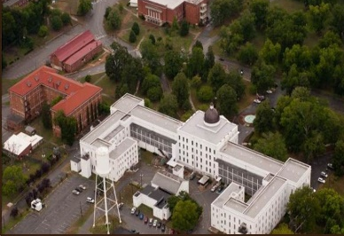
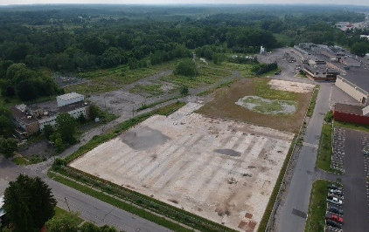
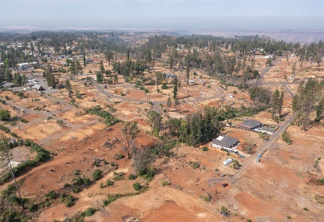
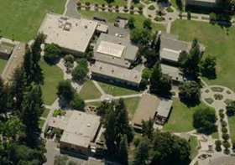
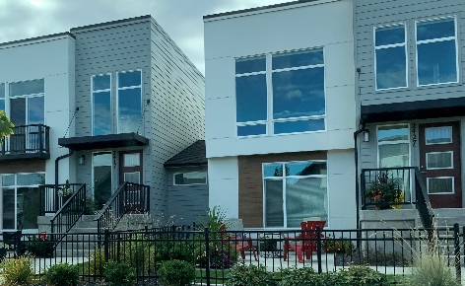
Economic Development
Fairborn, Ohio
Central State Hospital, Milledgeville, GA
Brownfield Redevelopment
Rome, New York
Preston, Connecticut
Military
Naval Air Station Oceana
Fort Ritchie
Disaster Response
Paradise, Calif.
New Orleans
Universities and Schools
Univ of Texas El Paso
Philadelphia Public Schools
International
Polish National Railway
ADIS Bulgaria
Affordable Housing
Spokane, Wash.
Orlando Coalition for the Homeless
Faith-Based Institutions
St. Andrews Presbyterian Church
Diocese of Charleston
Notes:
Among its assignments, the Consulting Corps worked with the City of Virginia Beach and the U.S. Navy to analyze the real estate assets and offer a development plan for a portion of the 5,331-acre Naval Air Station Oceana in Virginia Beach. The team, led by Jerry Turner, CRE, provided a framework for the Navy to examine redevelopment options, consider alternative leasehold structures, and work with key stakeholders to explore and implement public-private partnerships. Additional collaboration with the U.S. Navy is planned in 2025.

Slide 8
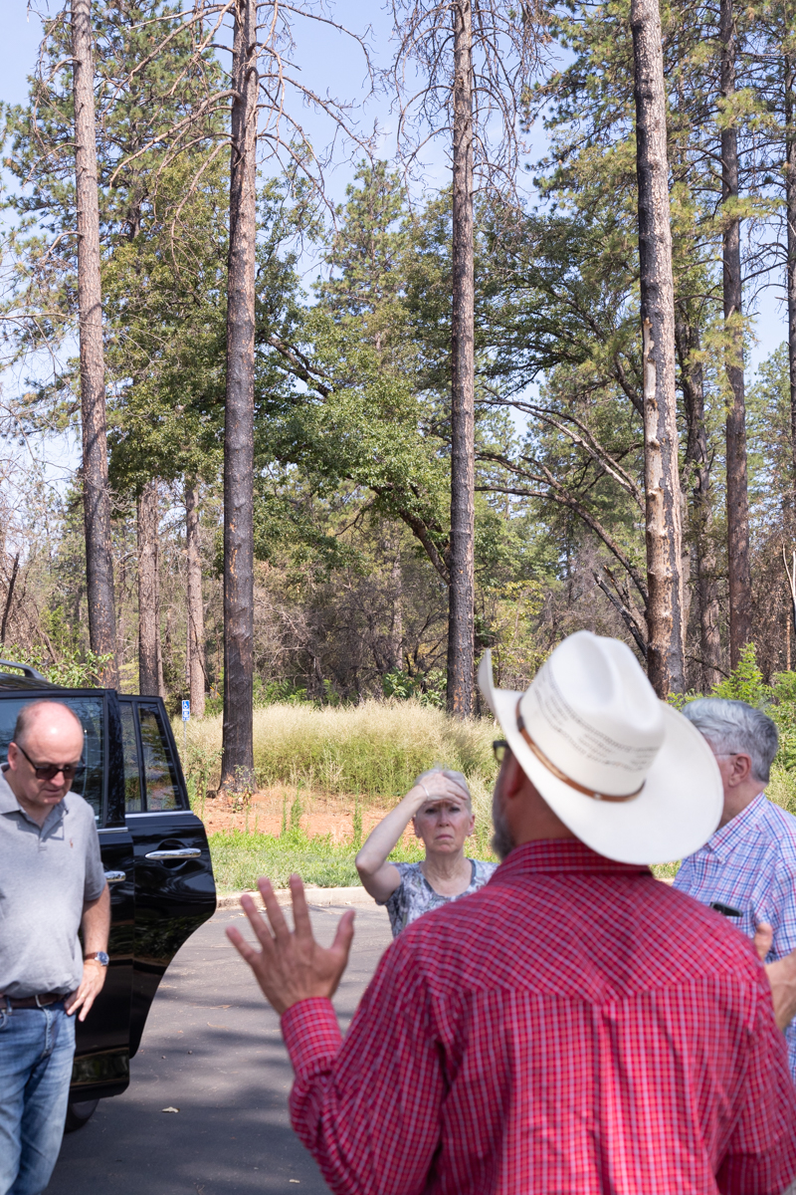
Rebuilding Paradise
“I kept hearing about all the problems [preventing rebuilding]. This powerhouse of brilliant people who can process the information objectively is helping us get out of our own way. This has far exceeded my expectations.”
Aubrey Pruis, Association Executive Paradise Association of REALTORS®
Notes:
A team of Counselors led by Steve Norris, CRE, proposed a real estate roadmap to help rebuild the town of Paradise, CA, following the 2018 Camp Fire – the most destructive and deadliest fire in California history, and the worst in the U.S. in more than a century. The team’s work continues today.

Slide 9
Support The CRE® Foundation
Take the Chapter Challenge!
Do You Know of a Deserving Organization in Your Market?
Partner with Your Chapter or Colleagues to Identify a Cause
Propose a Project for Funding by the CRE® Foundation
Make An Impact and Help Build CRE® Brand Recognition
Email Us at foundation@cre.org!
Notes:
We need your help with investing CRE Foundation funds in your community. The Foundation requires that a Counselor of Real Estate be involved in either the grant application process or in actively monitoring or implementing the project. Thus, your help in identifying additional opportunities is important. Visit CRE.ORG for details.

Slide 10
Take
Our
Money!

Slide 11
Notes:
The Counselors of Real Estate’s Economic Advisory Council is a group of American and European advisers with a stellar reputation for economic forecasting. Members include the executive director and principal economist at CBRE, chief economists at MSCI Real Assets and Manulife Investment Management, managing director of Nuveen Real Estate, the heads of research and strategy at AEW Europe and MetLife Investment Management, and professors of real estate at NYU and Clemson. The 16 Counselors offer compelling analysis and interpretation of economic indicators, fiscal policies, and property market data, and explain in an entertaining manner how convergence of the three is impacting asset classes and the industry in general. ​
​

Slide 13
Free Monthly Webinars
Notes:
Launched during the pandemic, along with the Specialty Interest Groups, the What’s Next webinar series has introduced the CRE credential and the Counselors organization to a wide audience, with registrations reaching as high as 1,000.

Slide 14
Specialty Interest Groups
ASSET & PROPERTY MANAGEMENT
FINANCE
COMMERCIAL DEVELOPMENT
HOUSING
ESG
INFRASTRUCTURE
Notes:
Think out loud in these interactive forums that provide Counselors invaluable opportunities to collaborate, exchange information, offer perspective, and pose questions to CREs of similar specialty in an atmosphere of trust and cooperation. Attend any of the meetings as your schedule allows and benefit from these topical discussions. A special “SIG Palooza” is planned for the week of February 3, 2025, during which all 12 groups will meet.

Slide 15
Specialty Interest Groups
INSTITUTIONAL INVESTMENT
LIFE SCIENCES
LEASING
STATE & LOCAL TAXES
LEGAL
VALUATION

Slide 16
Real Estate Issues®
Notes:
Our peer-reviewed professional journal, Real Estate Issues, is the premier forum in which the world’s foremost real estate thought leaders present innovative ideas, novel strategies, and intriguing commentary on all matters relating to real property.

Slide 17
Want $10,000?
Notes:
The Jared Shlaes Prize, a $10,000 award presented annually, recognizes an article published in Real Estate Issues. The Prize, envisioned and endowed by the family of the late Jared Shlaes, CRE (1930 – 2020), honors the legacy of Mr. Shlaes, creator and founder of Real Estate Issues. The award seeks to honor authors whose literary style makes a complex real estate subject clear to the broadest audience possible.

Slide 18
Who Do You Know?
Tell us the name of a colleague (or two) that you know who might be interested in—and qualified for—membership.
GIVE US A NAME AT CRE.ORG!
Notes:
Scan the QR Code to submit a name of a qualified member prospect and we’ll follow up with that individual!

Slide 19
Volunteer in 2025!
Get Involved Through Committee and Public Service Opportunities!
Notes:
Scan the QR Code for details on the role of each committee and key current initiatives of The Counselors. Member engagement is the foundation of our success!

Slide 20
