Slide 1

Global Property Markets 2024:
Trends. Cultures. Perspectives.
  Richard Barkham, Ph.D.
    Global Chief Economist &
    Global Head of Research
July 24th, 2024

Slide 2
Global inflation is trending down
Core CPI, YoY, %
Source: US BLS, EuroStat, UK Office for National Stats, China NBS, Japanese Statistics Bureau

Slide 3
Central Bank interest rates have started to fall
Global Central Bank interest rates, %
 | U.S. | U.K. | EU | Canada | China | Japan
Recent High | 5.50% | 5.25% | 4.50% | 5.00% | 4.35% | -0.10%
Current Rate | 5.50% | 5.25% | 4.25% | 4.75% | 4.35% | 0.10%
Source: Federal Reserve, Bank of England, ECB, Bank of Canada, People’s Bank of China, Bank of Japan, June 2024.

Slide 4
A soft landing is underway
GDP Growth Comparisons (Annual Averages)
Horizontal bars show and numbers show average 2010-19 growth rates
1.8%
Source: CBRE House View June 2024

Slide 5
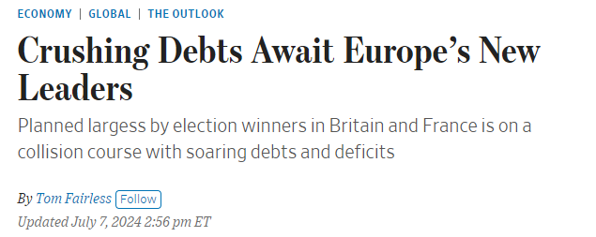
Government finances – the problem no one wants to deal with
Government Balance, % of GDP
Source: Oxford Economics, July 2024

Slide 6
Bond rates are elevated and volatile
Global 10 Year Government Bond Rates
Source: Macrobond

Slide 7
Capital values continue to drift down – or do they?
Global Capital Values Index, 2003 Q1 =100
Source: CBRE Research, CBRE Economic Advisors, Q2 2024 (Prelim)

Slide 8
Thank You.
Dr. Richard Barkham
Global Chief Economist &
Head of Americas Research
CBRE Research
+1 617 912 5215
richard.barkham@cbre.com
Jacob Cottrell
Senior Research Analyst
Global Research
CBRE Research
+1 618 407 8353
jacob.cottrell@cbre.com
This presentation has been prepared in good faith based on CBRE’s current views of the commercial real-estate market. Although CBRE believes its views reflect market conditions on the date of this presentation, they are subject to significant uncertainties and contingencies, many of which are beyond CBRE’s control. In addition, many of CBRE’s views are opinion and/or projections based on CBRE’s subjective analyses of current market circumstances. Other firms may have different opinions, projections and analyses, and actual market conditions in the future may cause CBRE’s current views to later be incorrect. CBRE has no obligation to update its views herein if its opinions, projections, analyses or market circumstances later change.
Nothing in this presentation should be construed as an indicator of the future performance of CBRE’s securities or of the performance of any other company’s securities. You should not purchase or sell securities – of CBRE or any other company – based on the views herein. CBRE disclaims all liability for securities purchased or sold based on information herein, and by viewing this presentation, you waive all claims against CBRE and the presenter as well as against CBRE’s affiliates, officers, directors, employees, agents, advisers and representatives arising out of the accuracy, completeness, adequacy or your use of the information herein.
^{© Copyright 2021 CBRE}

Slide 9

Global Property Markets 2024:
Trends. Cultures. Perspectives.
  Dennis Schoenmaker, Ph.D.
    Executive Director &
    Global co-Head of Forecasting & Data Analytics
July 24th, 2024

Slide 10
Investment volumes off to a slow start but positive signals ahead?
Cumulative Daily Global CRE Investment Volume (Billions, USD)
Fraction of quarterly CRE Investment Volume as a share of the cyclical peak (US)
Source: MSCI-RCA, CBRE Econometric Advisors
Source: MSCI-RCA, CBRE Econometric Advisors
Notes:
Commercial-Property Loans Coming Due in US Jump to $929 Billion – Bloomberg
MBA Chart of the Week: 2024 Commercial Mortgage Maturities Pushed Up by 2023 Extensions - MBA Newslink
$929B In Commercial Property Loans Set To Mature In 2024 (bisnow.com)
Debt funding gap arises in multifamily sector | CBRE

Slide 11
But what about Distress? Different impacts across the globe
Debt Funding Gap by Sector for Loans Originated During 2019-2022* (Billions, USD)
Debt funding gap globally (billions, USD)
 | Published | Period | Absolute Gap
U.S. Offices* | May 2024 | 2024 – 2027 | $ 127 bn
U.S. Multifamily* | May 2024 | 2024 – 2027 | $34 bn
Europe Office | December 2023 | 2024 – 2027 | $ 66 bn
Europe All | December 2023 | 2024 - 2027 | $ 123 bn
APAC All | May 2023 | 2023 - 2025 | $ 5.8 bn
Source: CBRE Research & CBRE Econometric Advisors
Source: CBRE Econometric Advisors
*This chart is an updated version of Figure 1 from “Debt Funding Gap Arises in Multifamily Sector” published by CBRE EA on October 25, 2023.
Notes:
Commercial-Property Loans Coming Due in US Jump to $929 Billion – Bloomberg
MBA Chart of the Week: 2024 Commercial Mortgage Maturities Pushed Up by 2023 Extensions - MBA Newslink
$929B In Commercial Property Loans Set To Mature In 2024 (bisnow.com)
Debt funding gap arises in multifamily sector | CBRE

Slide 12
Why offices? The working from home trend demystified
Aggregate Vacancy Rates, 2019 – Q1 2024
Vacancy Rate comparison (%)
Source: CBRE ERIX & Econometric Advisors
Source: CBRE Econometric Advisors
Notes:
Commercial-Property Loans Coming Due in US Jump to $929 Billion – Bloomberg
MBA Chart of the Week: 2024 Commercial Mortgage Maturities Pushed Up by 2023 Extensions - MBA Newslink
$929B In Commercial Property Loans Set To Mature In 2024 (bisnow.com)
Debt funding gap arises in multifamily sector | CBRE

Slide 13
Flight from commodity office stock and the flight to ‘prime offices’
Increase In Vacant SF (‘000 SF), Q1 2024 less Q1 2020
Top 16 Markets: Vacancy Rate in the US (%)
Source: CBRE Econometric Advisors
Source: CBRE Econometric Advisors
Notes:
Commercial-Property Loans Coming Due in US Jump to $929 Billion – Bloomberg
MBA Chart of the Week: 2024 Commercial Mortgage Maturities Pushed Up by 2023 Extensions - MBA Newslink
$929B In Commercial Property Loans Set To Mature In 2024 (bisnow.com)
Debt funding gap arises in multifamily sector | CBRE

Slide 14

Global Property Markets 2024:
Trends. Cultures. Perspectives.
  Yoshio Nakayama
    President / Representative Director
    XYMAX Real Estate Institute
July 24th, 2024

Slide 15

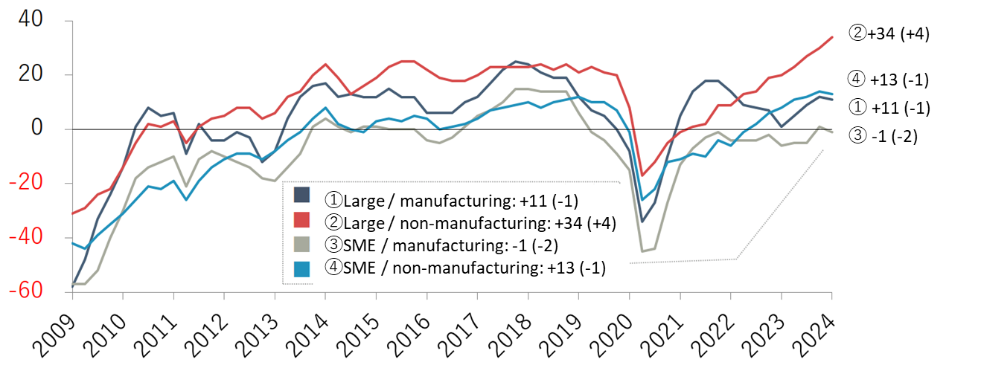
Japan Economy Overview
Key Economic Indicators
 | 2023 | Q1 2024
Real GDP (%) | 1.8 | -0.7
Core CPI (%) | 3.1 | 2.6
Base Rate (%) | -0.039 | 0.074
JGB Yield (10 yrs, %) | 0.6 | 0.7
Tankan DI (Biz Sentiment) | 13 | 12
Nikkei 225 Index | 33,464 | 40,369
Japan GDP growth is expected to be slow down to -0.7% due to sluggish external demands in China.
BOJ’s Tankan DI (Biz Sentiment) for the non-manufacturing (②) marked the highest level of +34, reflecting a boost from the strong recovery in overseas tourism.
BOJ abandoned its negative rate policy by increasing the base rate from -0.1% to 0.1% in Mar 2024.
Long-term yield remained calm below 1% following the BOJ’s above decision.
Source: Compiled by XYMAX REI from various data
Tankan DI (Biz Sentiment) -detail
Source: Short-Term Economic Survey of Enterprises in Japan, Bank of Japan

Slide 16
Office – How big is Tokyo Office Market?
Office Stock in Japan by major city
Population: Tokyo 14mil. / Japan 124 mil. = 11.3%
Greater Tokyo: 38mil., the largest metropolis in the world
Tokyo occupies approx. 60% of Japan office stock.
Osaka, the 2nd largest market, is still 26% of Tokyo
Tokyo has larger office stock than NYC and LDN.
100
429mil sq.ft.
26
111mil sq.ft.
11
8
5
4
46mil sq.ft.
32mil sq.ft.
22mil sq.ft.
17mil sq.ft.
1 tsubo = 3.3 sqm = 35.58 sqft
1 sqm = 10.76 sq.ft.
Source: Compiled by XYMAX REI based on Sanko Estate Data

Slide 17
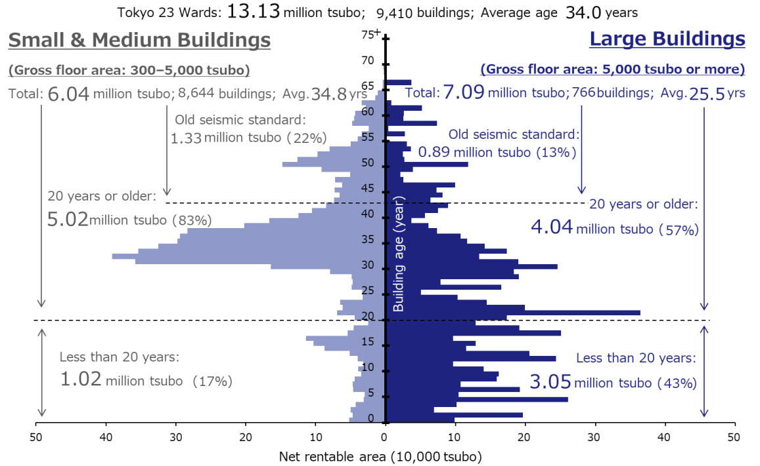
Feature of Tokyo office stock: ”Office Pyramid”
Tokyo 23 Wards Office Stock Pyramid 2024 (Net Rentable Area)
“Office Pyramid” simply shows the feature of Tokyo office stock.
The office stock is 13.13 million tsubo (467million sq.ft.) on a rentable area basis.
Large Bldg.: Owned by large corporation (including RE company), institutional investors, funds and REITs, @25.5yr.old
Small & Medium Bldg.: Mainly owned by small companies and individuals, @34.8yr.old
(467 million sq.ft.)
Bldg. Age
(GFL: 11,000 – 178,000 sq.ft.)
(GFL: 178,000 sq.ft. and above)
(215 million sq.ft.)
(252 million sq.ft.)
(47 million sq.ft.)
(32 million sq.ft.)
Large volume of office supply in Babble period
(179 million sq.ft.)
(144 million sq.ft.)
Continuous new office supply after Yr. 2000
(36 million sq.ft.)
(108 million sq.ft.)
1 tsubo = 3.3 sqm = 35.58 sqft
Source: XYMAX REI “Office Pyramid 2024”

Slide 18
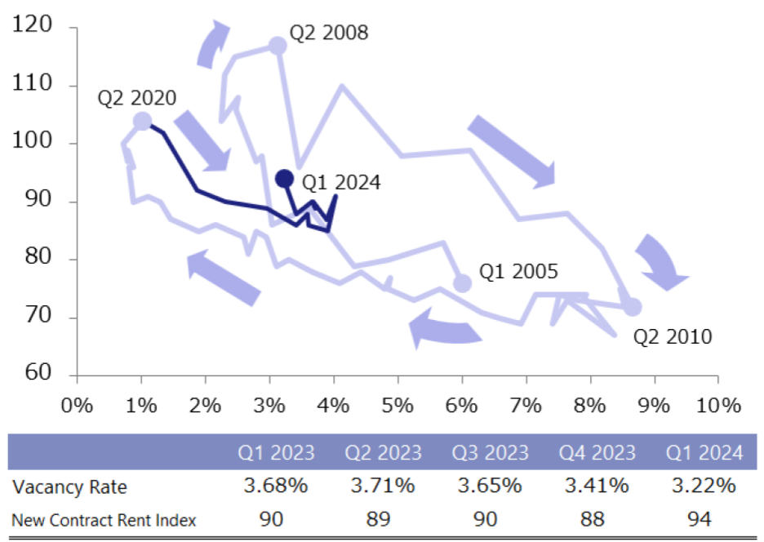
Office Market Cycle in Tokyo 23 Wards
Office Market Cycle in Tokyo 23 wards
New Contract Rent Index
(1) Lehman Shock starts
Peak
(V: 3.13%, R: 117)
The market trend can be grasped by looking at the movement of vacancy rate and rent.
(1) Lehman Shock: Vacancy increased +5.52%, Rent index dropped -45pt
(2) COVID-19: Vacancy increased +3.01% (now: +2.21%), Rent index dropped -13pt (now: -10pt)
(2) COVID-19 starts
(V: 1.01%, R: 104)
Peak
NOW
(V: 3.22%, R: 94)
V: +2.21%, R: -10pt
Trough
Q3 2022
(V: 4.02%, R: 91)
V: +3.01%, R: -13pt
Trough
(V: 8.65%, R: 72)
V: +5.52%, R: -45pt
Vacancy Rate
Source: XYMAX REI “Office Market Report Tokyo Q1 2024”

Slide 19
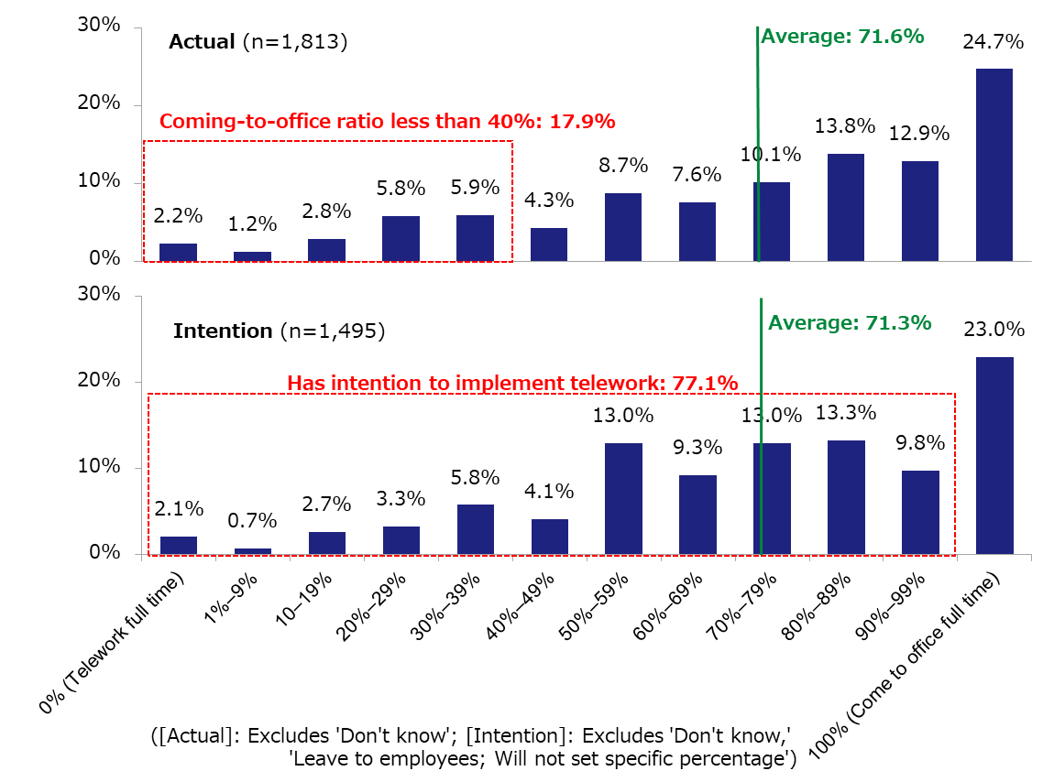
Office attendance rate (current / future intent)
Office Attendance Rate (actual and intention, all major cities in Japan, companies)
Actual:
About 25% of the companies implement 100% office attendance
18% of companies have less than 40% office attendance
Intention:
About 23% of the companies intend to return to 100% office attendance
77% of the companies don’t intend to return to 100% office attendance, and maintain teleworking
Source: XYMAX REI “Metropolitan Areas Office Demand Survey Spring 2024”

Slide 20
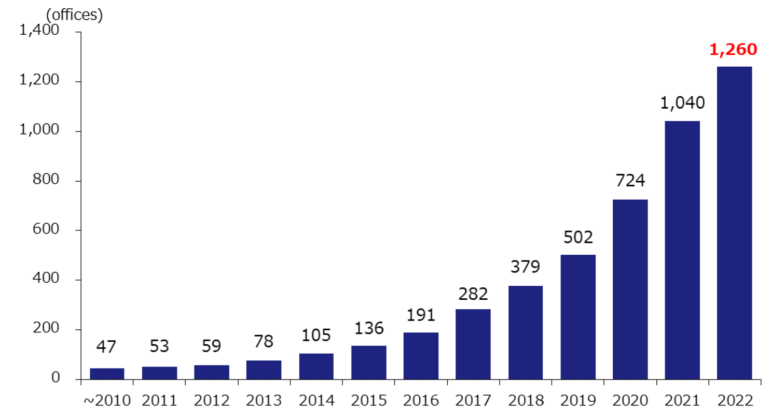
Continuous demand growth on flexible office
Number of Flexible Offices (Tokyo 23 wards)
Mainstream of corporate workplace strategy is “Hybrid” work.
Many companies start to adopt flexible offices for employee’s teleworking place.
There are 1,260 flexible offices spanning approx. 239,000 tsubo (8.5 mil sq.ft.) in the Tokyo 23 Wards. The number has been increasing year by year.
The total floor area of flexible offices in the Tokyo 23 Wards is more than 2% of the office stock.
Source: XYMAX REI “Flexible Office Market Survey 2023”

Slide 21
Demand on office expansion is increasing
Future Change in Office Size
Around 35% feel current main office is “very small” or “somewhat small”.
“Want to expand” office size is increasing.
Top five reasons for office expansion:
Not enough meeting rooms (53.7%)
To improve comfort of office environment (50.9%)
Increase in number of people (50.0%)
To accommodate personnel increase due to future intensified hiring (40.9%)
To motivate employees (35.8%)
Source: XYMAX REI “Metropolitan Areas Office Demand Survey Spring 2024”

Slide 22
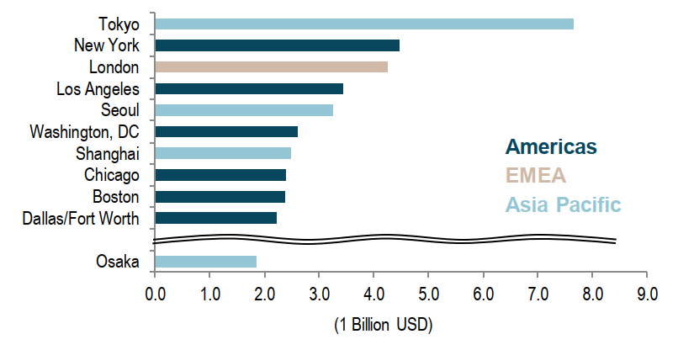
Capital market: Japan is a key destination
Global City Ranking by Investment Volume (Q1 2024)
Japan remains top market for cross-boarder investment (by CBRE 2024 Asia Pacific Investor Intensions Survey).
Tokyo was first with a total investment volume of USD 7.65 billion in Q1 2024, up from fifth place for the full year 2023.
Osaka was in 16th place at USD 1.84 billion, significantly up from 36th place for the full year 2023.
#1 (#5)
#16 (#36)
Source: JLL Japan Research May 2024 Investment Market Summary Japan Capital Flow 1Q2024

Slide 23
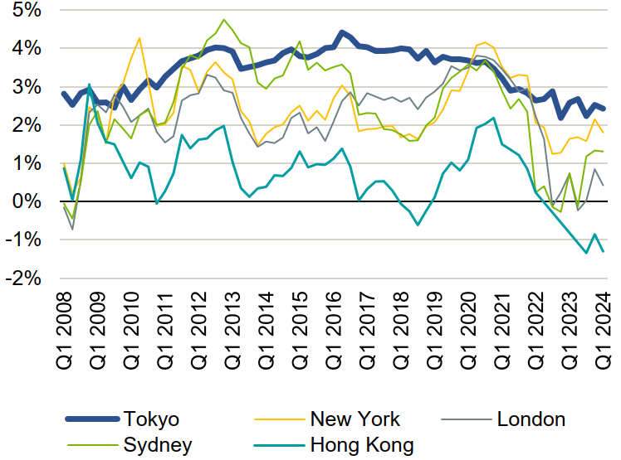
Major reasons for investing in Tokyo
Office Yield Spread (Average Transacted)
The largest metropolis with 38 million population in the world
Low country risk and stable real estate market
High liquidity with many players
Relatively wide and stable yield spread comparing with other major markets (see chart)
Accessibility of finance and low financing cost
Recent weak Yen exchange rate (benefitted to inbound investors)
Source: DWS “Japan Real Estate Market Outlook Report May 2024”

Slide 24
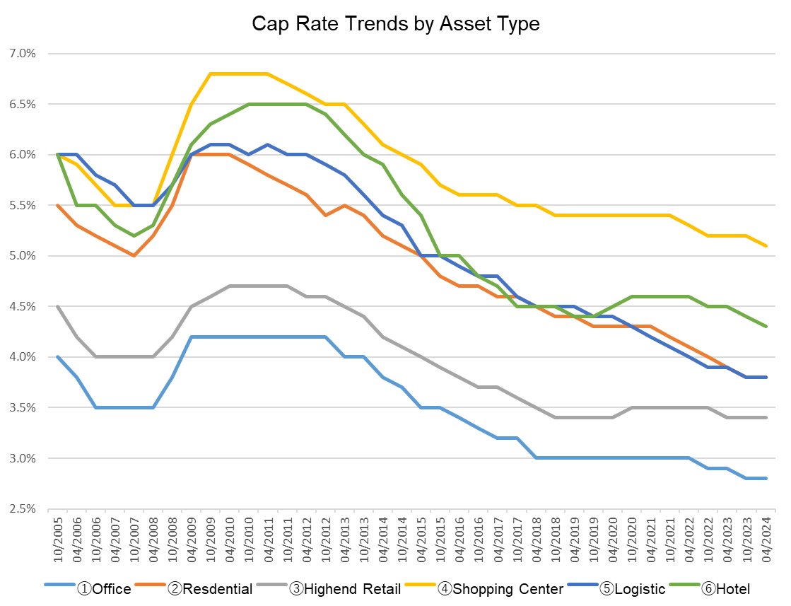
Cap Rate Trends by Asset Type
Cap Rate Trends by Asset Type
④Shopping Center
⑥Hotel
②Residential
⑥Logistics
③High-end Retail
Lehman shock
COVID 19 starts
①Office
Source: Compiled by XYMAX REI based on Japan Real Estate Institute “Real Estate Investor Survey”

